Slide 1


LIFEGUARD: Saving the Network Outage Hassle with the HOFF
Colin Scott
With Dr. Professor Ethan Katz-Bassett, Dave Choffnes, Italo Cunha,
Arvind Krishnamurthy, and Tom Anderson
Notes:
Thanks everyone for coming. As part of my thesis, I’m going to argue to you today that the Internet is broken, and that we did to help fix it with the HOFF.

Slide 2
A Quick Survey
Raise your hand if you used the Internet / email:
…since you got to this room?
…in the last hour?
…today?
Notes:
At this point, I’m going to assume anyone with hand down is too busy checking email to have heard the question
My point is that we all depend on the Internet

Slide 3
We need the Internet to be reliable
We increasingly depend on the Internet:
Yesterday: Email, web browsing, e-commerce
Today: Skype, Google Docs, NetFlix
Tomorrow: Thin clients + cloud services, outpatient medical monitoring,…
So, we expect it to be highly available.
Does it achieve this goal?
Notes:
Traditional apps like email and web browsing. E-commerce sites rely on the Internet’s reliable operation for their business
Now, we use to access data and apps in the cloud, to watch movies, and to talk on the phone. We want our cloud data to be reliably available, and we want our movies and phone calls to be smooth
Have to hang up multiple times and retry call
We’re moving towards a world where we’re much more dependent on the Internet
Future: most apps are in the cloud, most communication is over the Internet, want to run critical services
For these apps, we have to be able to rely on the Internet
Are we ready for that?
I’m going to show you that the current answer is no, but that we can take concrete steps towards improving it
What’s the current situation?

Slide 4
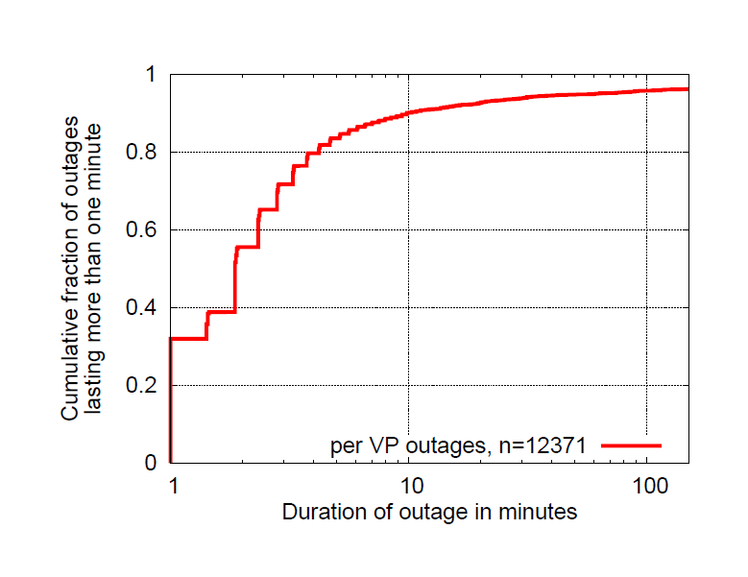
Lots of long-lasting outages
4 EC2 instances monitoring 250 targets
12,371 outages over one month
~10% lasted longer than 10 minutes
Notes:
Motivate with internship story.
Emphasize Not during my internship.
This motivated us to study EC2 more in depth.
How this is different from public studies. EC2, holy shit!
US-WEST, US-EAST, EU-WEST, Singapore
sending pings to 250 targets from the top 50 ISPs
ranked according to UCLA's topology data
one measurement round every 60 seconds

Slide 5
Most are partial
Approx 80% are partial
Number of vantage points
Partial reachability implies more than just a hardware failure!
Notes:
Same outages as previous. Bucketing by VP. -> conclusion
And they’re partial, which means we can do something about it!

Slide 6
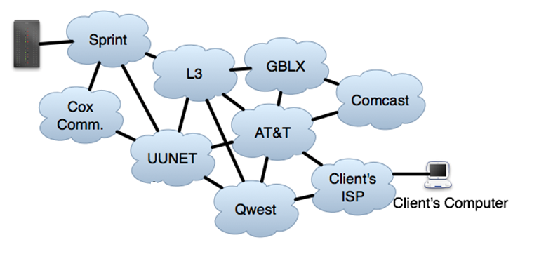
But where are the outages?
Anywhere along the path
State of the art: traceroute
Gives an incomplete view
Amazon
Server
Notes:
Tie back to anectode. Clients everywhere, don’t have visibility, don’t have control, still need to fix
Diagram -> two different paths. (Partial reachability.)
Show Amazon. Show a client. Show asymmetry.
Cut the other computer

Slide 7
Example confusion (12/16/10)
“It seems traffic attempting to pass through Level3's network in the Washington, DC area is getting lost in the abyss. Here's a trace:”
– Outages.org list
User 1 1 Wireless_Broadband
2 BLTMMD.verzion.gni.net
3 PHIL.verzion-gni.net
4 IAD8.ALTER.NET
5 washington.dc.level3.net
6 * * *
User 2
1 192.168.1.1
2 washdc.verizon.gni.net
3 iad3.alter.net
4 washington.dc4.level3.net
5 chicago2.level3.net
6 denver1.level3.net
7 * * *
User 1: Broken link is in DC
User 2: Broken link is in Denver
Notes:
Now actual outage where operators were confused
Put on same slide

Slide 8
Goal
Detect and isolate wide-area outages
Provide diagnostic information to operators
On forward or reverse path?
Path in the working direction?
Alternate working paths?
Etc.
Notes:
Not fixing themselves
: requires path diversity, no stub Ases
: outages in PoPs affecting many paths
Bullet Points
Relate to AMZN graphs. Partial outage imply that alternate routes exist.
Structure

Slide 9
Solution: LIFEGUARD
LIFEGUARD: Locating Internet Fault Events and Generating Usable Alternate Routes Dynamically
Remainder of this talk:
Background
System implementation
Evaluation
Measurement study
Notes:
List of questions that we’re trying to answer. Beyond what traceroute tells you.
Direction

Slide 10


Background: traceroute
TTL=1
Source
Target
Source

Slide 11
Background: traceroute
R1
R1: Time Exceeded
Source
Target

Slide 12
Background: traceroute
R1
TTL=2
Source
Target
Notes:
Describe what R1 is. What S and T are.

Slide 13
Background: traceroute
R1
R2
R2: Time Exceeded
Source
Target

Slide 14
Background: traceroute
R1
R2
R1
TTL=3
Target
Source
Target

Slide 15

Background: traceroute
R1
R2
R1
Target
Source
Target
?
Notes:
Relate back to traceroute example.. This is what we saw earlier, trails off…

Slide 16
Background: traceroute
?
X
R1
R2
R1
Target
Source
Target
Notes:
It might be in the forward direction…

Slide 17
Background: traceroute
R1
R2
R1
X
Target
Source
Target
?
Notes:
Getting somewhere!, but failing on the way back
Like in L3 example
Insert additionaln information we want here. With the architecture diagram.

Slide 18

Solution: LIFEGUARD
First, detect outages with the HOFF: High-impact Online Failure Finder
Key techniques in LIFEGUARD:
Leverage multiple vantage points
Spoofed pings + spoofed traceroute
Historical path atlas
Reverse traceroute
LIFEGUARD provides:
(Working) direction
View into paths before outage
Location of failure

Slide 19
Isolating the direction
S’
R1
R2
R1
Ping?
Source: S’
Target
Source
Target
Spoofing: pretending you’re another computer
Notes:
What is spoofing?
Pretend we’re someone else, trick the router
Text

Slide 20
Isolating the direction
S’
R1
R2
R1
Target: Pong
Target
Source
Target
Spoofing: pretending you’re another computer

Slide 21
Isolating the direction
Ping?
Source: S
S’
R1
R2
R1
Target
Source
Target
Spoofing: pretending you’re another computer

Slide 22
Isolating the direction
S’
R1
R2
R1
Target
Source
Target
Target: Pong
Spoofing: pretending you’re another computer

Slide 23
Measuring the working direction
S’
R1
R2
R1
Target
Source
Target
TTL=3
Source: S’
Reverse path failure: use spoofed forward traceroute
Notes:
Moving to a different question now. What does working direction look like?

Slide 24
Measuring the working direction
R3: Time Exceeded
S’
R1
R2
R3
R1
Target
Source
Target
Reverse path failure: use spoofed forward traceroute
Notes:
Even though not pingable from the source (remind of what the gray means)

Slide 25
Measuring the working direction
R4: Time Exceeded
S’
R1
R2
R3
R1
R4
Target
Source
Target
Reverse path failure: use spoofed forward traceroute

Slide 26
Measuring the working direction
Target: Pong
S’
R1
R2
R3
R1
R4
Target
Source
Target
Reverse path failure: use spoofed forward traceroute

Slide 27
Isolating the fault
S’
R2
R3
R1
R3
R1
R4
X
R4
Target
Source
Target

Slide 28
Isolating the fault
S’
S’
R2
R3
R1
R3
R1
R1
R1
R4
R4
Target
Target
Target
Source
Target
R5
Measure working paths with reverse traceroute

Slide 29
Isolating the fault
S’
S’
R2
R3
R1
R3
R1
R1
R1
R4
R4
Target
Target
Target
Source
Target
R5
X
OK, somewhere on R3’s reverse path
But where?
Notes:
Reverse paths are confusing

Slide 30
Tracking paths before the outage
Each host traceroutes each target
VPs
Targets
Notes:
How often do paths change? Not that often… which is why this is helpful

Slide 31
Tracking paths before the outage
Each host measures reverse paths
VPs
Targets
Notes:
Refresh at a rate of every 4 hours

Slide 32
Isolating the fault
S’
R1
R2
R3
R1
R4
Target
Source
Target
R8
R5
R6
R7
View into historical paths
Notes:
Show

Slide 33
Isolating the fault
S’
R1
R2
R3
R1
R4
X
Target
Source
Target
R8
R5
R6
R7
Ping?
Issue pings to infer reachability
Notes:
Show forward failure first. Answer questions. Then introduce more complicated reverse case. Same pieces, solve the same problem
Show ping animations. Emphasize what colors mean, edges, etc.

Slide 34
Measuring the working direction
S’
S’
R2
R1
R2
R1
R1
R1
Target
Target
Target
Source
Target
Source
R8
R5
R6
R7
Forward path failure: use reverse traceroute

Slide 35
Isolating the fault
S’
X
S’
R2
R1
R2
R3
R1
R1
R1
R4
Target
Target
Target
Source
Target
Source
R8
R5
R6
R7
Forward path failure: near last hop of traceroute

Slide 36
Putting it all together
LIFEGUARD:
Leverages multiple vantage points
Determines and measures working direction (if any)
Forward: spoofed forward traceroute
Reverse: spoofed pings towards source, reverse traceroute
Provides a view into historical paths
Isolates the failure
Forward/Bidirectional: spoof traceroute
Reverse-only: reverse traceroute from each fwd hop, ping historical hops
Notes:
In the context of those questions

Slide 37
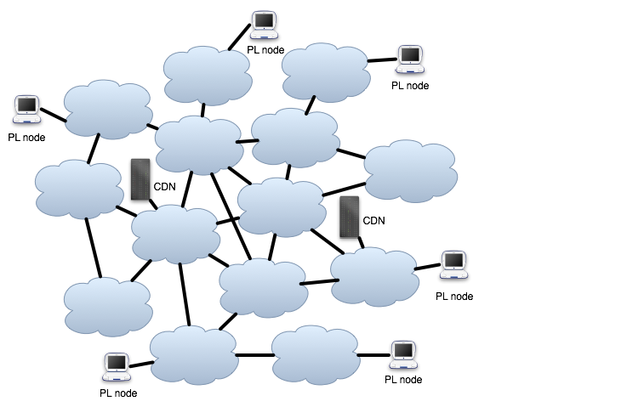
Deployment
LIFEGUARD has been running for 4 months
12 PlanetLab VPs
monitoring:
73 other PL nodes
83 core routers
185 edge routers
16 CDN nodes
Notes:
Monitor between first,
Then CDN
Blah
Blah
Why we chose them

Slide 38
Validation
May 24th at 11:39pm, LIFEGUARD identified
ae3-3.erb1.Chicago2.Level3.net as a suspected failure.
Outages.org:
“Saw issues routing through Chicago via Level3 starting around 11:05pm, cleared up about 11:43pm.”
Confirmed by other operators
Notes:
So we just talked about system, now we’ll look at how well it works
We find real failures…
After, walk through a few examples

Slide 39
Evaluation
Observed 778 outages over four months
>22,000 partial outages overall; LIFEGUARD aggressively filters
Last hop of traceroute differed from suspected failure for 30% of outages
Without knowing direction, can’t tell if traceroute is correct
Direction:
Isolate the failure to either the forward or reverse path for 53%
Measure the full opposite direction for 63% of uni-directional
Provide historical path information:
for >80%
Identify alternate working paths for 49%
Notes:
Illustration with real example
Make sure to motivate alternate working paths.
Distinction between traceroute, rest is what we provide
Is 53% good? As a number, doesn’t sound good

Slide 40
What did we find?
Category | Count
Horizon confined to AS | 10
Horizon crosses domains | 22
Multi-homed Provider link | 37
Missing Historical revtr | 137 (oops!)
Next hop unreachable | 195
Path Change | 163
Next hop reachable | 229
}
Reverse Path Outages
}
Forward/Bidirectional Outages
Notes:
Implications of these numbers!
People had /no/ visibility into reverse path failures before

Slide 41
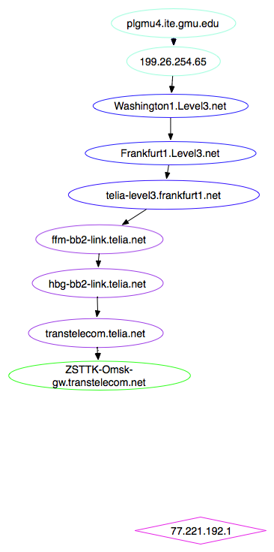
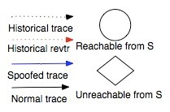
What did we find?
Category | Count
Horizon confined to AS | 10
Horizon crosses domains | 22
Multi-homed Provider link | 37
Missing Historical revtr | 137 (oops!)
Next hop unreachable | 195
Path Change | 163
Next hop reachable | 229

Slide 42
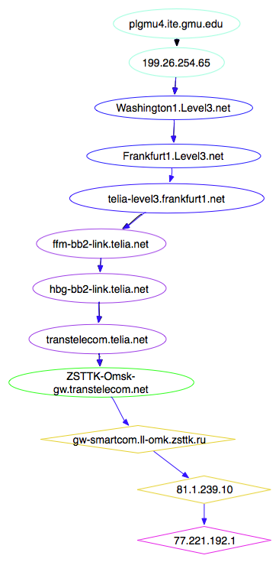
What did we find?
Category | Count
Horizon confined to AS | 10
Horizon crosses domains | 22
Multi-homed Provider link | 37
Missing Historical revtr | 137 (oops!)
Next hop unreachable | 195
Path Change | 163
Next hop reachable | 229

Slide 43
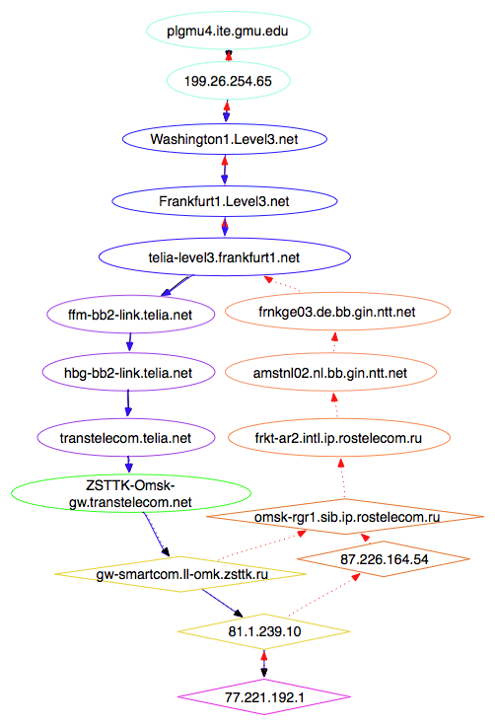
What did we find?
Category | Count
Horizon confined to AS | 10
Horizon crosses domains | 22
Multi-homed Provider link | 37
Missing Historical revtr | 137 (oops!)
Next hop unreachable | 195
Path change | 163
Next hop reachable | 229
X

Slide 44
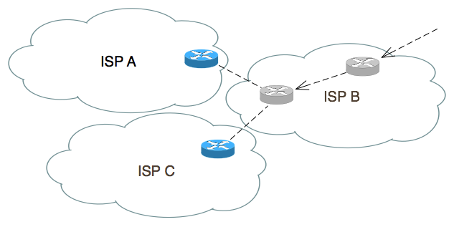
What did we find?
Category | Count
Horizon confined to AS | 10
Horizon crosses domains | 22
Multi-homed Provider link | 37
Missing Historical revtr | 137 (oops!)
Next hop unreachable | 195
Path Change | 163
Next hop reachable | 229

Slide 45
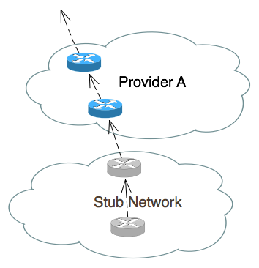
What did we find?
Category | Count
Horizon confined to AS | 10
Horizon crosses domains | 22
Multi-homed Provider link | 37
Missing Historical revtr | 137 (oops!)
Next hop unreachable | 195
Path Change | 163
Next hop reachable | 229

Slide 46

What did we find?
What did we find?
Category | Count
Horizon confined to AS | 10
Horizon crosses domains | 22
Multi-homed Provider link | 37
Missing Historical revtr | 137 (oops!)
Next hop unreachable | 195
Path Change | 163
Next hop reachable | 229
Category | Count
Horizon confined to AS | 10
Horizon crosses domains | 22
Multi-homed Provider link | 37
Missing Historical revtr | 137 (oops!)
Next hop unreachable | 195
Path Change | 163
Next hop reachable | 229

Slide 47

What did we find?
What did we find?
Category | Count
Horizon confined to AS | 10
Horizon crosses domains | 22
Multi-homed Provider link | 37
Missing Historical revtr | 137 (oops!)
Next hop unreachable | 195
Path Change | 163
Next hop reachable | 229
Category | Count
Horizon confined to AS | 10
Horizon crosses domains | 22
Multi-homed Provider link | 37
Missing Historical revtr | 137 (oops!)
Next hop unreachable | 195
Path Change | 163
Next hop reachable | 229

Slide 48
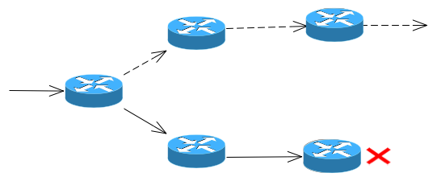
What did we find?
What did we find?
Category | Count
Horizon confined to AS | 10
Horizon crosses domains | 22
Multi-homed Provider link | 37
Missing Historical revtr | 137 (oops!)
Next hop unreachable | 195
Path Change | 163
Next hop reachable | 229
Category | Count
Horizon confined to AS | 10
Horizon crosses domains | 22
Multi-homed Provider link | 37
Missing Historical revtr | 137 (oops!)
Next hop unreachable | 195
Path Change | 163
Next hop reachable | 229

Slide 49

What did we find?
What did we find?
Category | Count
Horizon confined to AS | 10
Horizon crosses domains | 22
Multi-homed Provider link | 37
Missing Historical revtr | 137 (oops!)
Next hop unreachable | 195
Path Change | 163
Next hop reachable | 229
Category | Count
Horizon confined to AS | 10
Horizon crosses domains | 22
Multi-homed Provider link | 37
Missing Historical revtr | 137 (oops!)
Next hop unreachable | 195
Path Change | 163
Next hop reachable | 229

Slide 50
Future Work
Correlate across vantage points, destinations, and time
Improvements: choose targets more rigorously, verify that alternate working paths are valid,…
PAMELA: Poisoning Ases for Machiavellian Event Location Avoidance
LIFEGUARD II: When the HOFF identifies an outage, PAMELA steers traffic to safety
Scale to the Internet! Get network operators to use it!
Notes:
Pamela explanation

Slide 51
Summary
The Internet is unreliable, with many long-lasting outages
EC2 study confirmed that these outages impact cloud infrastructure
Operators lack tools to diagnose these problems
LIFEGUARD: a real system for wide-area fault isolation
Large-scale outage monitoring
Infer/measure working direction
Spoofed pings / traceroute
View into routing before outages
Historical, rapidly refreshed path atlas
Algorithm for isolating failures
Pings to infer reachability
Failures can be isolated, regardless of direction!
Notes:
Finally, found that distributed measurement systems are a lot of fun!

Slide 52
Questions?

